Slide 1
Naïve Bayes Practical Example

Slide 2
Text | Tag
“A great game” | Sports
“The election was over” | Not sports
“Very clean match” | Sports
“A clean but forgettable game” | Sports
“It was a close election” | Not sports
which tag does the sentence A very close game belong to?

Slide 3
Since Naive Bayes is a probabilistic classifier, we want to calculate the probability that the sentence “A very close game” is Sports and the probability that it’s Not Sports. Then, we take the largest one.
Written mathematically, what we want higher of the two
P(Sports | a very close, game)— the probability that the tag of a sentence is Sports given that the sentence is “A very close game”.
P(not Sports | a very close, game)— the probability that the tag of a sentence is Not Sports given that the sentence is “A very close game”.

Slide 4
Feature Engineering
The first thing we need to do when creating a machine learning model is to decide what to use as features. We call features the pieces of information that we take from the text and give to the algorithm so it can work its magic. For example, if we were doing classification on health, some features could be a person’s height, weight, gender, and so on. We would exclude things that maybe are known but aren’t useful to the model, like a person’s name or favorite color.
In this case though, we don’t even have numeric features. We just have text. We need to somehow convert this text into numbers that we can do calculations on. We use word frequencies.

Slide 5
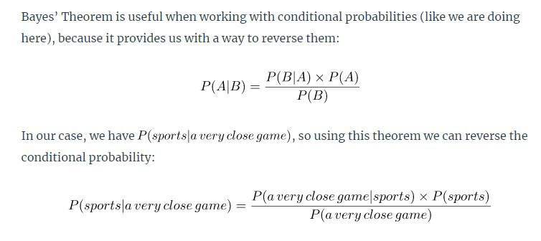

Slide 6
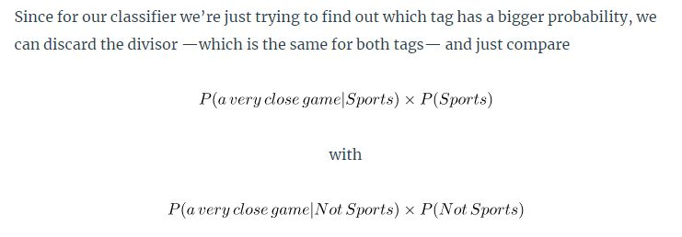

Slide 7

Being Naive
So here comes the Naive part: we assume that every word in a sentence is independent of the other ones. This means that we’re no longer looking at entire sentences, but rather at individual words. So for our purposes, “this was a fun party” is the same as “this party was fun” and “party fun was this”.
We write this as:

Slide 8

Above assumption is very strong but super useful. It’s what makes this model work well with little data or data that may be mislabeled. The next step is just applying this to what we had before:

Slide 9
Calculating Probabilities
First, we calculate the a priori probability of each tag: for a given sentence in our training data, the probability that it is Sports P(Sports) is ⅗. Then, P(Not Sports) is ⅖. That’s easy enough.
Then, calculating P(game | Sports) means counting how many times the word “game” appears in Sports texts (2) divided by the total number of words in sports (11). Therefore, P(game | Sports) = 2/11.

Slide 10
Split the sentences into words whose tag is sports
(A, great ,game, Very ,clean ,match, A ,clean, but, forgettable, game)
Total =11
P(A|Sports)=2/11
P(very|Sports)=1/11
P(close|Sports)=0/11

Slide 11
Laplace Smoothing
However, we run into a problem here: “close” doesn’t appear in any Sports text! That means that P(close | Sports) = 0. This is rather inconvenient since we are going to be multiplying it with the other probabilities, so we’ll end up with
P(a | Sports)*P(very | Sports) *0 *P(game | Sports). This equals 0, since in a multiplication if one of the terms is zero, the whole calculation is nullified. Doing things this way simply doesn’t give us any information at all, so we have to find a way around.
By using something called Laplace Smoothing we add 1 to every count so it’s never zero. To balance this, we add the number of possible words to the divisor, so the division will never be greater than 1.

Slide 12
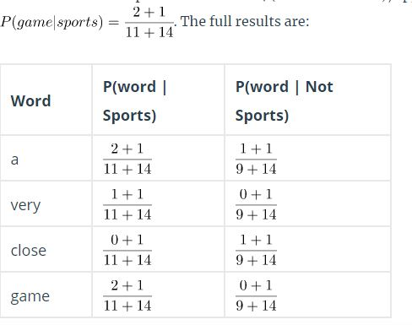
In our case, the possible words are ['a', 'great', 'very', 'over', 'it', 'but', 'game', 'election', 'clean', 'close', 'the', 'was', 'forgettable', 'match'].
Since the number of possible words is 14

Slide 13
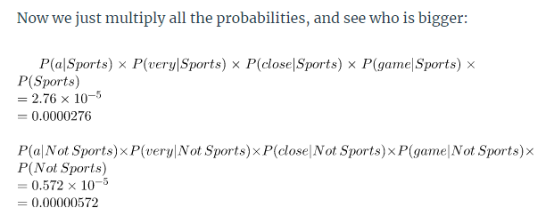
Final Result
Our classifier gives “A very close game” the Sports tag. Great!!!

